Slide 1
Market Research
Ravi Kiran

Slide 2
Market research
Market research is a process of understand a given market to explore if there is viable market for a given product created by a producer. This is a fundamental step every producer will need to do before investing on building a product. The research activity is an ongoing process as market continuously changes.
Market research provides the data on:
Current market performance and customer purchasing behavior
Future needs and changes to the product
Data and information on economy

Slide 3
Benefits
Avoid bad product decisions
Risk awareness
Strategy formulation

Slide 4
Challenges
Expensive and consumes time
Accuracy of findings
Problem of Bias

Slide 5
Market and Customer Data
Market and Customer Data includes
▪ Size and geography of the market ▪ Customer profiles and need ▪ Perception of current offerings and so on

Slide 6
Product data
Product data includes
Customer’s perception of product quality, value for money and other product related factors
Possible extensions and adjacencies of the product
Are there new markets for product and brand

Slide 7
Economy Data
Economy Data includes
Rate of economic growth and Inflation
Government economic policies

Slide 8
Competition Data
Competition Data includes
Competitor products and their prices
Customer value perception
Market share
Strengths and weaknesses
A view to future-plan and roadmap

Slide 9
PUMA
PUMA, is a German multinational company that designs and manufactures athletic and casual footwear, apparel and accessories.
Their segment specialize is sportswear Men and women who like sporty energetic apparel with a spray of uniqueness in their apparel.
They target urban young upper middle class and upper class men and women.
PUMA was founded in 1948. The business operates within the clothing and consumer goods manufacture industry

Slide 10
Marketing Research
Puma has various mission statements such as “ to be the fastest sports brand in the world” i.e., to be the popular sports brand and have a global reach.
Another is “to be the most desirable and sustainable Sports Lifestyle company in the world” i.e., people should have interest in sports and engage in sports activities and have a sustainable lifestyle.

Slide 11
Product Diversification
Puma has come a long way, from producing only footwear products to diversifying their products like Gymnasium equipment, Trekking Equipment.
Puma makes custom-made shoes, racer suits, and shoes for Formula One, Puma has been providing football shoes for football players and various equipment for various sports.

Slide 12
National Brand Ambassadors
Puma has signed deals with various sports personalities like Virat Kohli, KL Rahul, Sushma Verma, Sunil Chhetri to promote their brand.
Puma also endorses its products with different celebrities for example Saina Nehwal endorsed Badminton racket and cork.
Puma has made its brand image by making famous sports players who most Indians follow in their fields. their brand ambassadors influence people in buying their products.

Slide 13
CSR strategies
Puma had been providing Sports Scholarships to promote sports culture and also Anti Child Labour Campaign.
Puma has 10 sustainable goals to fulfill by 2050 ie Human rights, Being socially responsible, taking responsibility for environmental care, Biodiversity, using sustainable materials, less usage of chemicals, etc

Slide 14
Gaining Commercial Advantage from Research & Development
Instead of a Shoe Box and cover for the box, Puma started replacing them with Clever Little boxes to reduce the use of cardboard, paper, plastic, and less emission of Carbon Dioxide.
Let us now see the marketing budget of Puma.

Slide 15
Puma Social Media Strategy
Every different social media account has its unique use. Puma has managed all of its accounts properly and is posting all relevant content on its social media.

Slide 16
Methods of Market Research
Primary research
Gathering data directly from customers and market
Methods used ranges from questionnaires, surveys and experiments
Interviewing techniques are also important and sources can be internal or external

Slide 17
Secondary research
Data is gathered through sources like internet from records like annual reports, analysts reports and third-party databases
Other external sources include media reports, competitor reports and websites
Cheaper compared to primary research, but accuracy is lower relatively

Slide 18
Information Gathering Techniques
Observations is about observing customers closely and noting down their feelings, expressions, actions and attitude.
This will help designing of a shop floor to optimize customer’s journey and maximize convenience.

Slide 19
Information Gathering Techniques
Surveys involve a questionnaire on specific subject, for example what kind of toothpaste would you prefer(fluoridated or non-fluoridated) and so on.
Questions will be focused around getting customer preferences on a specific aspect of a product.
There can be several surveys related to a single product and can be conducted in several mediums such as direct contact, telephonic, email and online (websites).

Slide 20
Information Gathering Techniques
Experiments involve practical actions which will involve changing the price of the product, shape of the product, altering store layout and so on to observe the customer reaction.
This will help in understanding customers expectation visibly and act as per desire.

Slide 21
Information Gathering Techniques
Sampling involves collection of data from specific set of customers to save time.
Sampling technique selection play important role in determining quality of the outcome.

Slide 22
Sampling Techniques
Some of the sampling techniques are
Random sampling,
stratified sampling,
cluster sampling,
quota sampling and
snowballing sampling.

Slide 23
Market Segmentation
Market Segmentation divides the market into a meaningful divisions based on behavior, pattern, tastes or future trends.
For example, to sell a non-fluoridated toothpaste, one should choose a geography with high fluoride content in the local water bodies.
So the segmentation should be done based on water body’s fluoride content in each region.
Then producer can have a better understanding of market segment that will receive the product well.

Slide 24
Market Positioning
Once the segmentation is done and appropriate audience/segment is identified, the marketing team will prepare unique offering (product) to the targeted customers.
This attempt is called ‘Market Positioning’ of the product in the market.
Its about target market, target customers and unique value proposition about product vis-a-vis competition.

Slide 25
Market Segmentation
Market can be segmented in various ways such as
Segmentation by demographics- mass behaviors aspects of the population
Segmentation by Psychographics – behavioral aspects of individuals like attitudes, opinions, lifestyle etc.

Slide 26
Market Segmentation
Segmentation by geography – regional aspects where people live and stay
Segmentation by industry – type of industries, size , location and service requirements

Slide 27
Market Sizing
Purpose of market sizing is to understand the addressable market size which is relevant to the product we intend to sell.
‘Market Forecasting’ logically follows market sizing and involves various techniques that predict probable number of products/services, which can be sold in market of a given size.

Slide 28
Market Sizing
Lot of investment will be required when a product gets launched.
The market size should justify the investment required and confidence on sizing results is important to allow management to proceed with investment.

Slide 29
Market Sizing
Data is generally difficult to get for estimation activity.
Even if data is available, the accuracy, reliability of the data will be poor.

Slide 30
Market Sizing
During sizing it is equally important to understand other factors such as political, regulatory, demography and economy

Slide 31


Approaches
Defining the target of the sizing and problem product owner is trying to solve, ▪ Evaluation of existing or available data or lack of data, ▪ Choose method of collection of data related to market size, ▪ Evaluating the sufficiency and accuracy of the data after implementing the same
▪ Iteration with different data collection methods if required ▪ Review and estimation of market size with agreed data

Slide 32








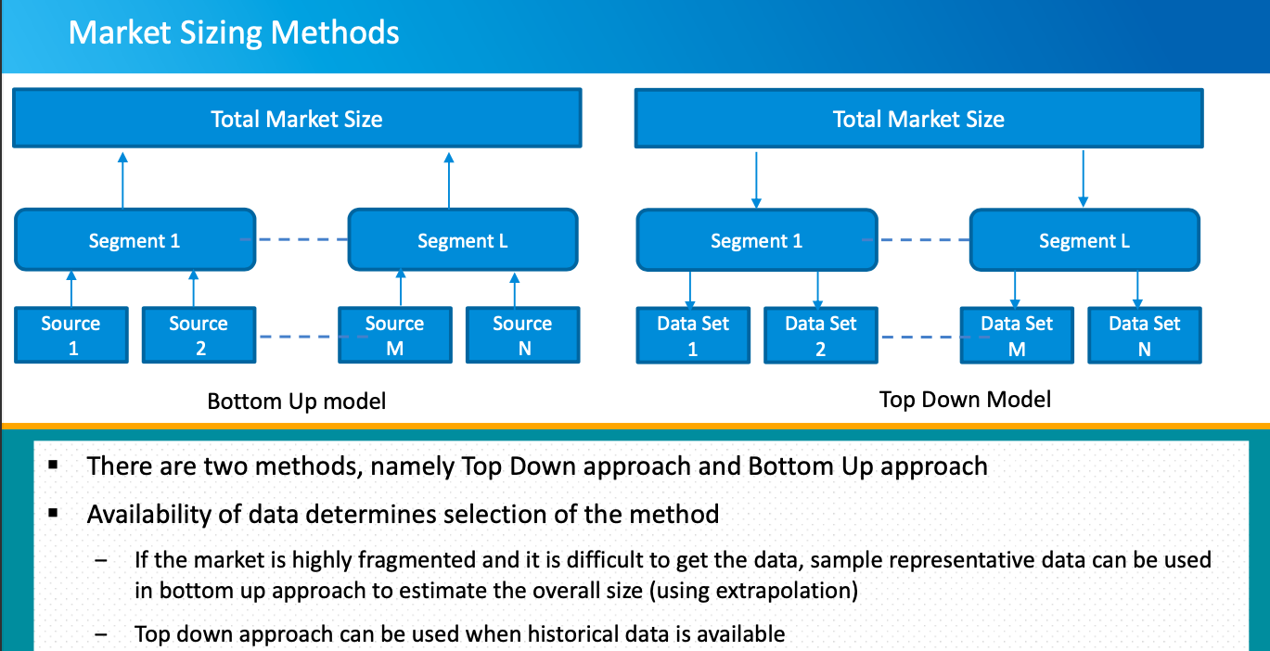

Slide 33
Summing Up
Market research is a process of understanding a given market to explore if there is viable market for a given product created by a producer. This is a fundamental step every producer will need to do before investing on building a product. The research activity is an ongoing process as market continuously changes.
There are several methods to conduct market research, namely primary and secondary.
Market segmentation divides the market into a meaningful divisions based on behavior, pattern, tastes or future trends.
‒ Some of the examples of segmentations are by geography, individual personalities, mass behaviors and industry type

Slide 34
Summing Up
Purpose of market sizing is to understand the addressable market size that is relevant to the product we intend to sell. Market forecasting is one of the objectives of market sizing.
There are two methods to size the market namely top down and bottom up methods.

